Slide 2
Objectives
Describe HTML5 forms
Explain the working of new input types in HTML5
Explain the new Form attributes
Explain the new Form elements

Slide 3
New Features in HTML5 Forms
  HTML5 Web forms bring great improvements related to form creation for the Web developers and also for users interacting with them.
The following are the changes introduced in HTML5 forms:
New form elements
New input types
New attributes
Browser-based validation
CSS3 styling techniques
Forms API

Slide 4
New Elements & Input Type
  HTML5 has introduced a range of new elements that are expanding the options for more number of elements related to input on the forms.
^{Elements}
^{progress}
^{meter}
^{datalist}
^{output}
^{Input Type}
^{email}
^{search}
^{url}
^{tel}
^{number}
^{range}
^{date}
^{Week}
^{month}
^{time}
^{datetime}
^{datetime-local}
^{color}
New Atrribute
^{placeholder}
^{required}
^{multiple}
^{autofocus}
^{pattern}
^{form}

Slide 5
Browser-based Validation
HTML4 supported the use of custom JavaScript or libraries to perform validation on the client-side browsers.
These validations ensure that the input fields are checked before the form is submitted to the server for further processing.
The new attributes in HTML5, such as required and pattern can be used with the input elements to perform validation.
This relieves the Web developers from writing the custom JavaScript code for performing client-side validation on the Web pages.
HTML5 also provides advanced validation techniques that can be used with JavaScript to set custom validation rules and messages for the input elements.
Notes:
Relieve : giảm bớt

Slide 6
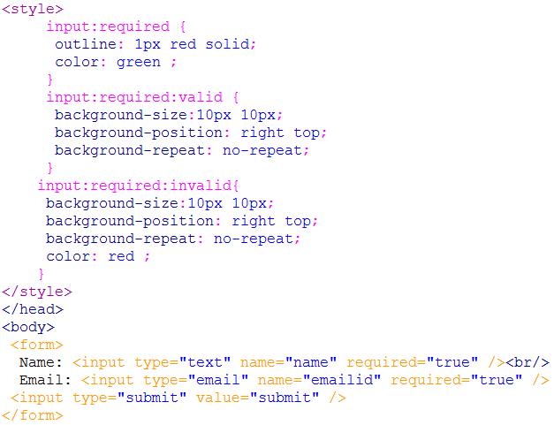


CSS Styling Techniques 1-2
  can enhance the form elements with the pseudo-class selectors, such as :required, :valid, and :invalid.
  The input fields which cannot be left blank while submitting the form can be displayed with an outline by styling the input field using CSS.

Slide 7
Forms API
  HTML5 has introduced JavaScript API for forms to customize validations and processing performed on the forms.
  The new Forms API provides new methods, events, and properties to perform complex validations combining fields or calculations.
  Following table lists the events and methods.
^{Events and Methods} | ^{Description}
setCustomValidity (message) | Sets the custom error message that is displayed when the form is submitted by the user
checkValidity() | Checks the validity of the e-mail address entered by the user
oninvalid | Allows script to run only when the element is invalid
onforminput | Allows script to run when a form gets a input from the user
onformchange | Allows script to run when the form changes

Slide 8
Working with New Input Types
  The type attribute of the <input> element determines what kind of input will be displayed on the user’s browser.
  The default input is type=”text”.
  the list of input types:
  text
  label
  radio
  textarea
  checkbox
  submit
  email
  url
  tel
  number
  range
  Datetime:time,date,week,month,datetime-local
  color

Slide 9
New Form Attributes
  HTML5 has provided several new attributes that perform the validations without writing JavaScript snippets for them.
  These attributes perform the following tasks:
    Check data provided by users with the regular expression pattern assigned to the fields
    Inform users with appropriate errors
    Check that the required fields are not left empty by the users
    Enable multiple values for the fields, if provided
  required
  placeholder
  Pattern:”[0-9]{6,20}”
  multiple
  autofocus

Slide 10
Form
  Earlier, all the form controls need to be provided between the opening and closing <form> tag.
  In HTML5, elements can be inserted at any place in the document and they can reference the form using the form attribute.
<body>
<input type=”text” name=”mytext” id=”mytext” form=”myform”/>
. . .
<form id=”myform”>
. . .
</form>
</body>

Slide 11

Autocomplete Attribute
The <input> element that can support autocomplete are text, url, tel, password, datepickers, range, and color.
The autocomplete feature comprises two states namely, on and off.
The on state : data that is not sensitive can be remembered by the browser.
The off state : the data will not be remembered.
Such data may be sensitive and not safe for storing with the browsers.
By default, many browsers have the autocomplete feature enabled in them.
The browsers that do not support autocompletion, can be turned on or off for this behavior by specifying autocomplete attribute.
E-mail: <input type=”email” name=”email” autocomplete=”off” />
<input type=”submit” value=”submit”/>

Slide 12
New Form Elements
  The new form elements are specifically designed to be used with the JavaScript.
  When combined with JavaScript, these new elements can be more functional.
  At present, all the browsers do not provide the support for these new elements.
  If the control is not supported by the browser, then it displays element as a text field.
  Opera provides the support for all the new form elements.
  Datalist
  Progress
  Meter
  Output

Slide 13
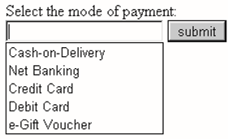
Datalist
  At present, only Opera browser provides the support for the datalist.
<label> Select the mode of payment: </label>
<input type=”text” name=”payment” list=”paymentlist” />
<datalist id=”paymentlist”>
<option value=”Cash-on-Delivery”>
<option value=”Net Banking”>
<option value=”Credit Card”>
<option value=”Debit Card”>
<option value=”e-Gift Voucher”>
</datalist>
<input type=”submit” value=”submit”/>

Slide 14

Progress
  The progress element represents the current status of a task, which gradually changes as the task heads for completion.
  This is not a form-specific element.
  For example, when the user downloads any file from a particular Web page, the download task is represented as a progress bar.
<label> Downloading status: </labl>
<progress value=”35” max=”100” ></progress>
<input type=”submit” value=”submit”/>

Slide 15
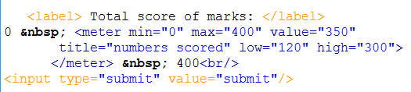



Meter
  The meter element represents a measurement scale for a known range.
  The known range has a definite minimum and maximum values
  For example, a meter element can be used to represent measurements, such as disk usage space, fraction value, or significance of a query result.
  All these have a known maximum value defined for them.

Slide 16
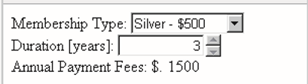
Output
  The output element displays the results of a calculation on a form.
  The result values displayed in the output element are processed from the other form elements.
<form oninput=”x.value = parseInt(type.value)*
parseInt(duration.value)”>
<label>Membership Type:</label>
<select name=”type”>
<option value=”400”>Gold - $400</option>
<option value=”500”>Silver - $500</option>
<option value=”600”>Platinum - $600</option>
</select>
<label>Duration [years]:</label>
<input type=”number” value=”0” name=”duration”
min=”1”max=”5” step=”1” />
<label> Annual Payment Fees: $.</label>
<output name=”x” for=”type duration”></output>

Slide 17
Summary
  HTML5 provides a great enhancement to Web forms.
  Creation of form is made easier for Web developers by standardizing them with rich form controls.
  HTML5 introduces new form elements such as new input types, new attributes, browser-based validation, CSS3 styling techniques, and forms API.
  HTML5 provides new input types that are data-specific user interface elements such as email, url, number, range, date, tel, and color.
  The new form elements introduced in HTML5 are datalist, progress, meter, and output.
  HTML5 has provided several new attributes that performs the validations without writing JavaScript snippets for them.
  In HTML5, one can use the submit input type for form submission.

